Slide 1
Defensive Security Project
By: Room 2,
Fahim Adil
Sam Corn
Sid Choudhuri
Kyra Chow
Melody Galloro
Amanullah Haidary
Hossainul Islam
Justin Legendre
Fatima Mansoor
Ryan Morgen
Daniel Nguyen
Tim Pang
Avram Sachinidis
Gerald Sequeira
Notes:
Justin

Slide 2
Table of Contents
This document contains the following resources:
Monitoring Environment
Attack Analysis
Project Summary & Future Mitigations
Notes:
Justin

Slide 3

Monitoring Environment
‹#›

Slide 4
Scenario
Our employer tasked us with creating a monitoring solution to help protect their Windows and Apache servers against a malicious competitor.
We were provided with logs of regular activity (which is not typical in the real world).
We used this crucial information to devise baseline thresholds of suspicious activity within Splunk Enterprise with reports and alerts.
These alerts are just that; they will notify security personnel of atypical activity but will not mitigate anything.
Additionally we created dashboards to quickly and efficiently display data in a streamlined panel of graphs.
We additionally used Whois XML IP Geolocation API addon for Splunk to pinpoint physical IP locations.
Notes:
Avram

Slide 5
Website Monitoring
‹#›

Slide 6
Website Monitoring
Summary:
Website monitoring apps can be a valuable tool for website owners and administrators, providing real-time monitoring and alerts to help quickly identify and resolve any issues that may arise. This app uses a modular input that can be set up quickly (in 5 minutes or less).
Features:
Uptime monitoring: This feature tracks the website's availability and alerts the user when the website goes down or becomes unavailable.
Performance monitoring: This feature tracks the website's performance, including load times, response times, and server resource usage, and alerts the user when performance falls below a certain threshold.
Error rate monitoring: This feature tracks the number of errors and 404 pages encountered by users, helping to identify and troubleshoot issues with the website.
Notes:
Hossainul

Slide 7
Website Monitoring
Alert notifications: This feature provides alerts via email, SMS, push notifications, or other channels when the website experiences an issue or goes down.
Historical data tracking: This feature provides data on website performance and uptime over time, allowing users to track trends and identify potential issues before they become critical.
Multiple monitoring locations: This feature allows the user to monitor the accessing website from various locations worldwide, providing a more accurate picture of website performance and availability.
Integration with other tools: Many website monitoring apps integrate with other tools, such as analytics platforms or incident management systems, to provide a more comprehensive view of website performance and streamline the incident resolution process.
These are just a few of the standard features of website monitoring apps. Depending on the user's needs, different apps may provide additional or variations on these core features. Therefore, considering various options and choosing a website monitoring app that provides the features and resources that meet your specific needs is essential.
Notes:
Hossainul

Slide 8
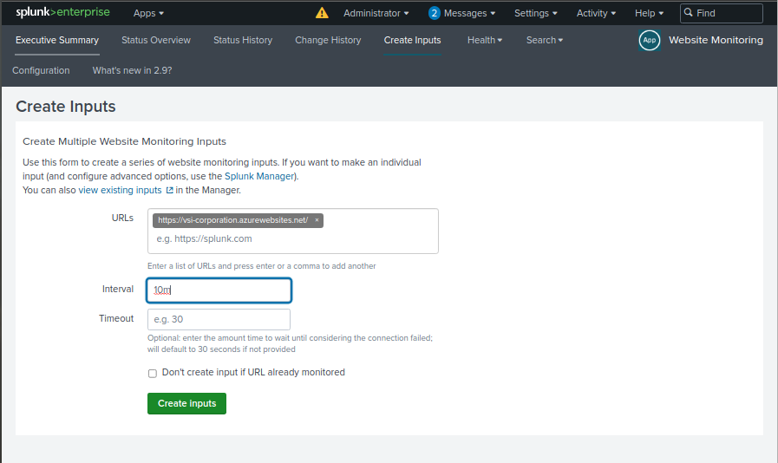
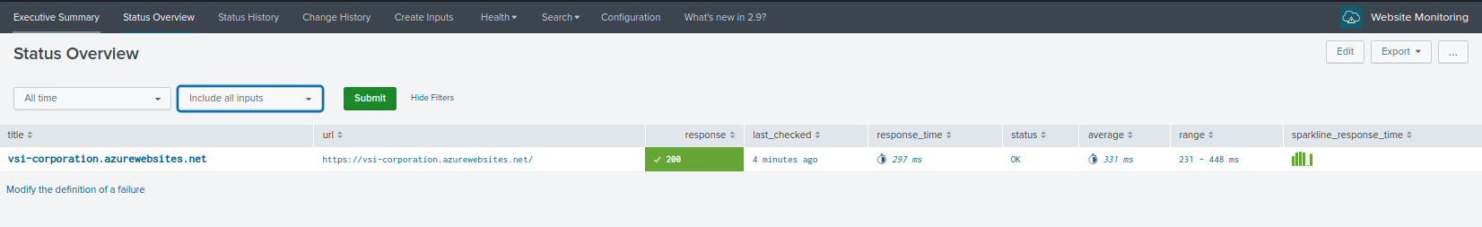
Website Monitoring
Notes:
Tim

Slide 9
Logs Analyzed
Windows Logs
Apache Logs
1
2
Windows event changes
Account Deleted
Account Login Successful
Account password reset
Status logs of success or failures
List of users who logged on
Severity/Event status
Different Logins from different domain locations
Different HTTP methods/requests to obtain information
Status of the website
Different ip addresses that requested
Notes:
Tim

Slide 10
Windows Logs
‹#›

Slide 11
Reports—Windows
Designed the following Reports:
Report Name | Report Description
Windows Events Signatures | A report with a table of signatures and associated signature IDs.
Windows Events Severity | A report that displays the severity levels, and the count and percentage of each.
Windows Events Status | A report that provides a comparison between the success and failure of Windows activities.
Notes:
Kyra

Slide 12
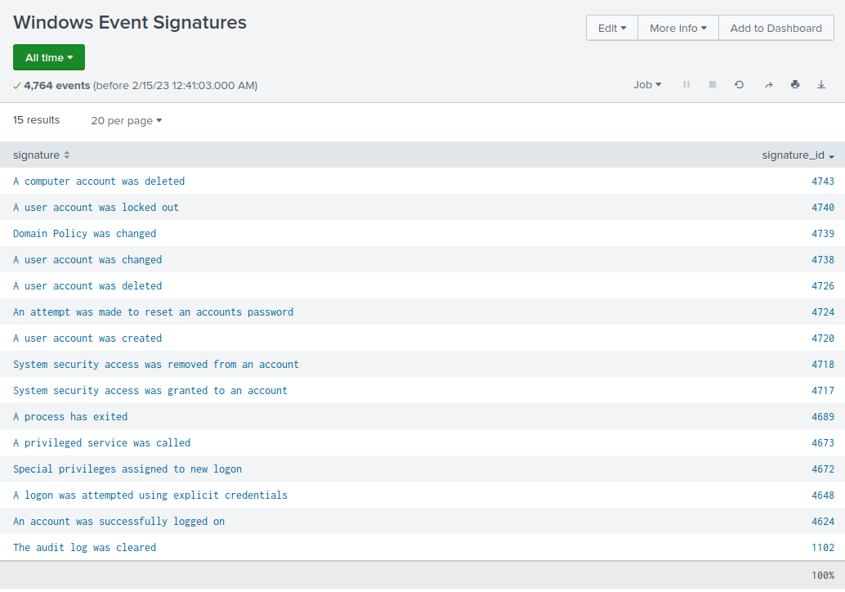
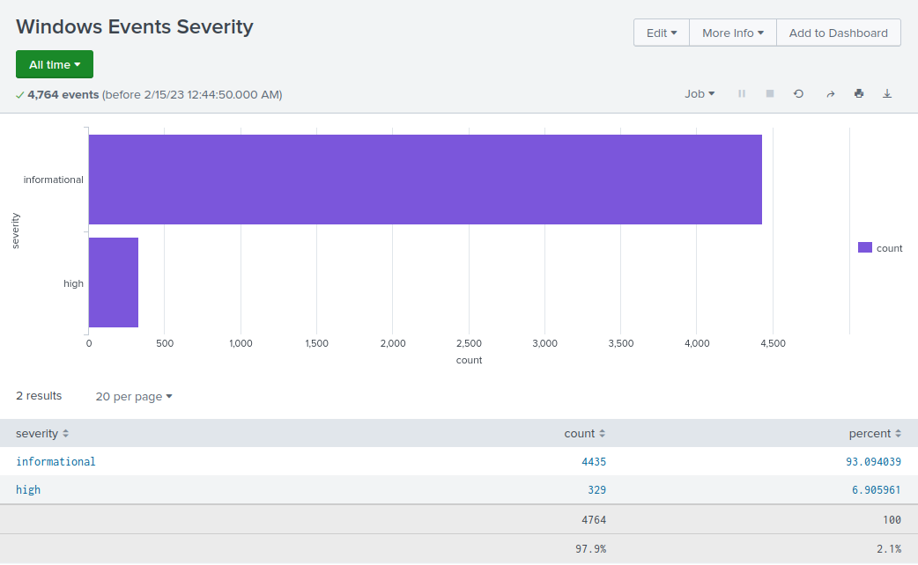
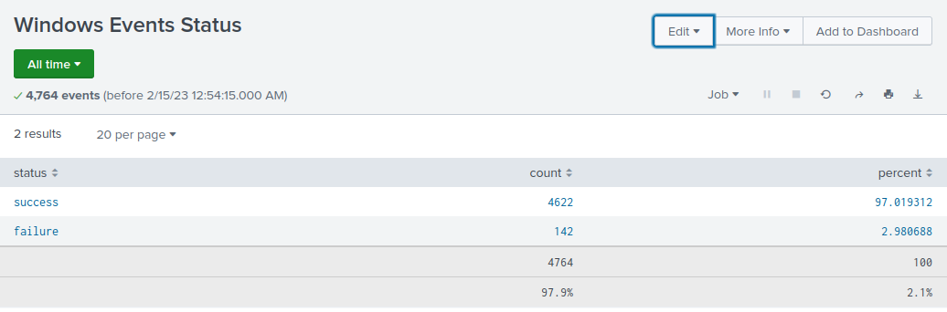
Images of Reports—Windows
Notes:
Kyra

Slide 13
Alerts—Windows
Designed the following alerts:
Alert Name | Alert Description | Alert Baseline | Alert Threshold
Windows Events Alerts - Failure | Windows failure status threshold = 20 per hour | Min = 2 Max = 10 | Threshold = 20
JUSTIFICATION:The max baseline failure rate per hour is 10. I chose a threshold double this value to avoid false positives.
Notes:
Gerald For the threshold. I had chosen to double the max baseline as it can be common for employees to mistype their password as there are numerous contribution factors such as lack of sleep, lethargic, feeling overworked, low energy, etc.

Slide 14
Alerts—Windows
Designed the following alerts:
Alert Name | Alert Description | Alert Baseline | Alert Threshold
Windows Events Alerts - Successfully logged in | Windows failure status threshold = Greater than 35 per hour | Min = 8 Max = 21 | Threshold = 35
JUSTIFICATION: The max baseline failure rate per hour is 21. I chose a threshold of 35, close to double the failure rate, to avoid false positives.
Notes:
Gerald Since the maximum baseline failure rate per hour is 21. I chose a threshold of 35 (70%) to be the maximum rate to avoid false positives.

Slide 15
Alerts—Windows
Designed the following alerts:
Alert Name | Alert Description | Alert Baseline | Alert Threshold
Windows Events Alerts - Deleted Accounts | Deleted accounts greater than 30 per hour | Min = 7 Max = 22 | Threshold = 30
JUSTIFICATION: The max baseline failure rate per hour is 22. I chose a threshold of 30 because account deletion should occur closer to the baseline than double the maximum threshold.
Notes:
Gerald I chose to slightly raise the threshold as deleted accounts is a very important event to be aware.

Slide 16
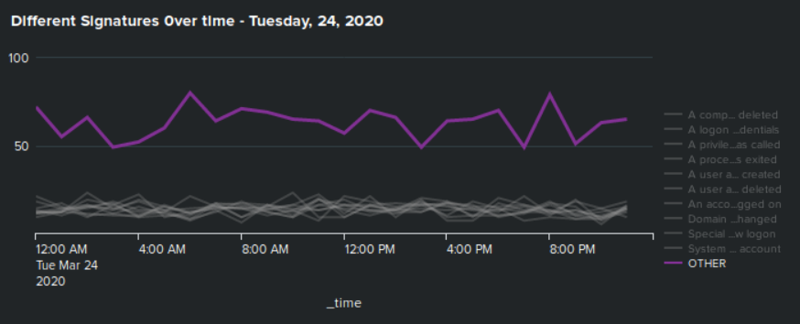
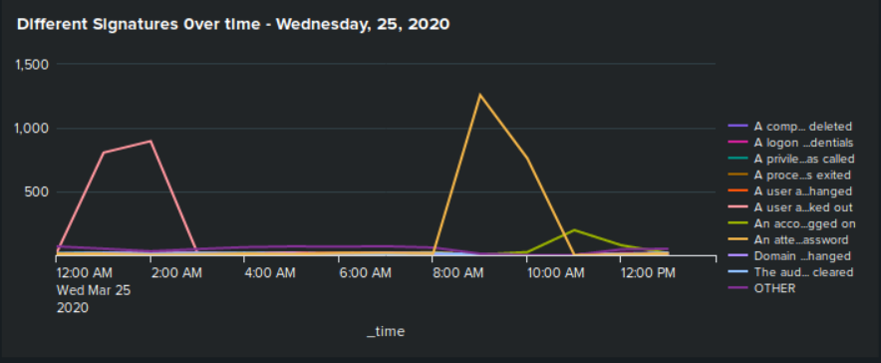
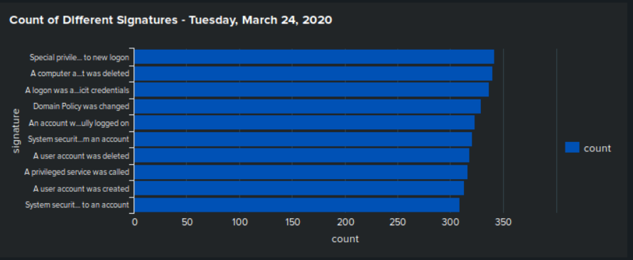
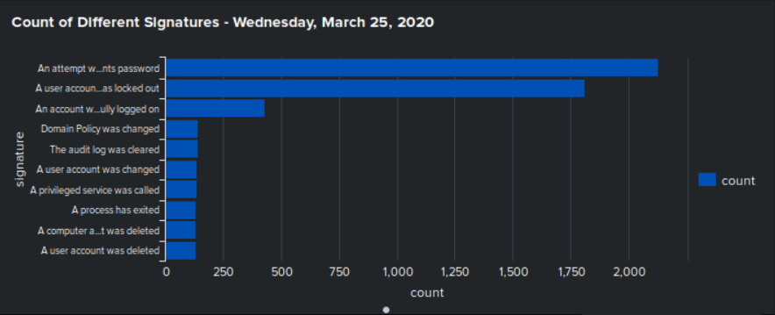
Dashboards—Windows
Place image here
Place image here
Place image here
Place image here
Notes:
Daniel

Slide 17
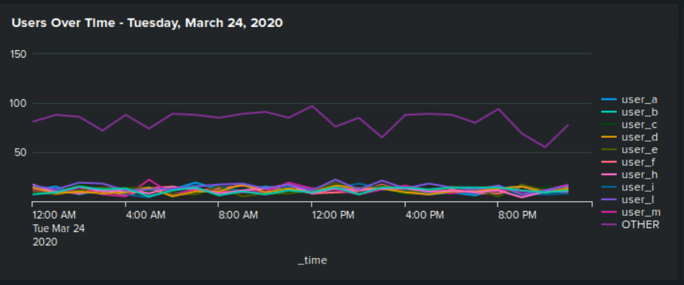
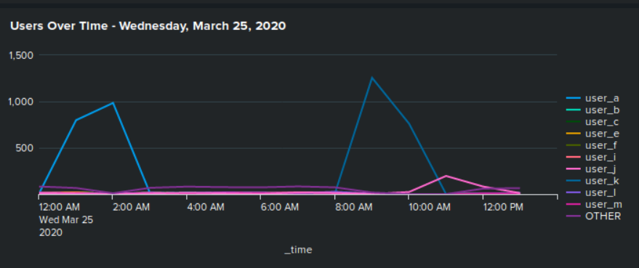
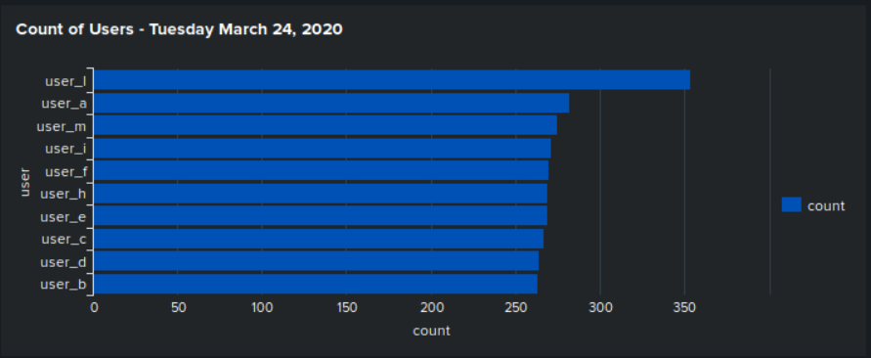
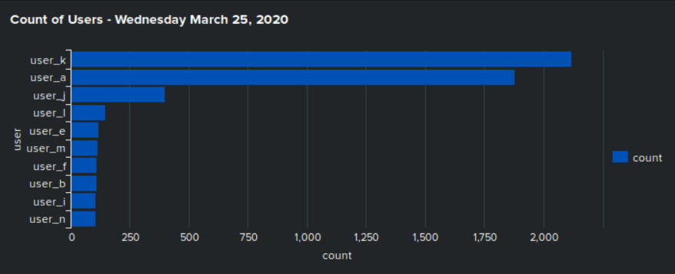
Dashboards—Windows
Place image here
Place image here
Place image here
Place image here
Notes:
Daniel

Slide 18
Apache Logs
‹#›

Slide 19
Reports—Apache
Designed the following reports:
Report Name | Report Description
HTTP Methods TABLE | HTTP activity status count of the type of GET, POST, HEAD and OPTIONS activity being requested against the VSI web server.
Top 10 VSI Domain Referrers | A list of the top 10 referring domains to identify any suspicious referring sites to VSI’s websites.
HTTP Response Codes | A report showing the count of each HTTP response code to provide insight into any suspicious levels of HTTP responses.
Notes:
Melody - The first report was to capture HTTP Method status activity against the VSI web server. Allow for richer communication between the browser and the server.
The second report was the list the Top 10 sites that link to the VSI sites content, the report will help to identify if there are suspicious sites referrering traffic.
The last report was to report on the HTTP response status codes that are issued by a server in response to a browser-sided request from a client. These codes are will help identify on whether requests are successful, redirected, or terminated due to an error.

Slide 20
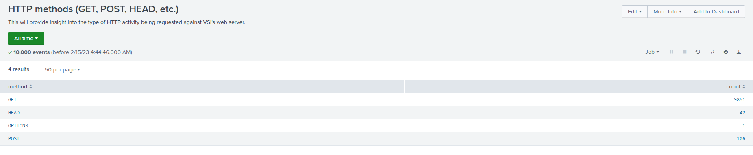
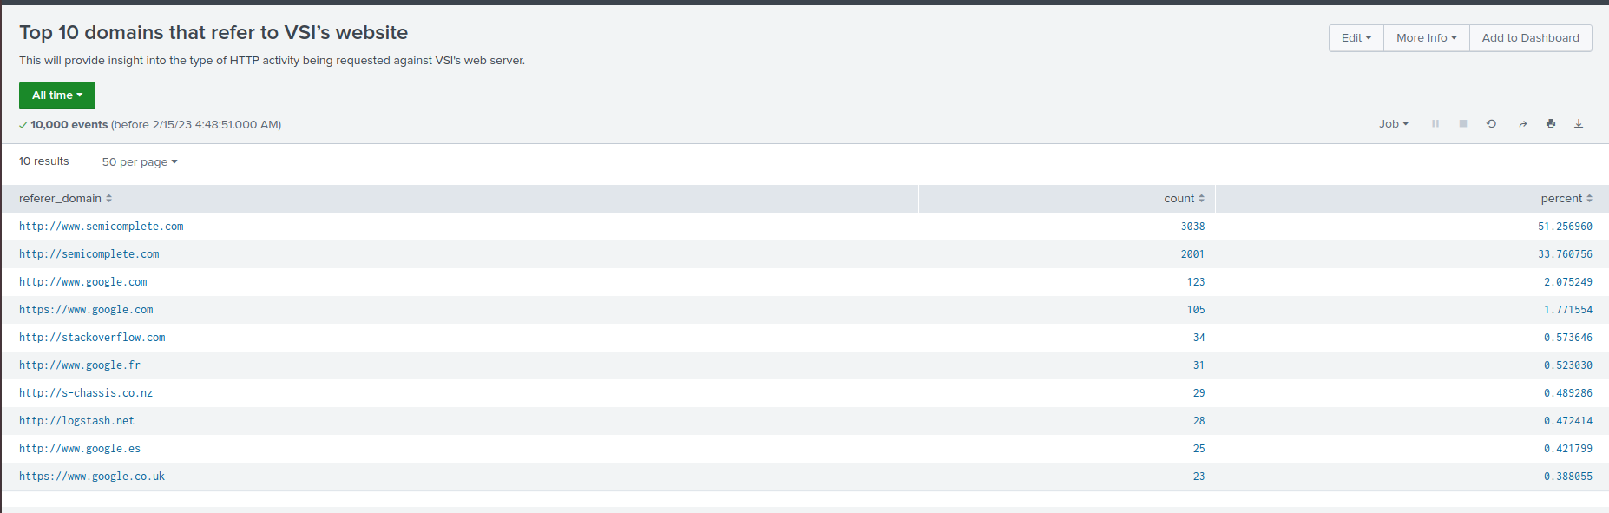
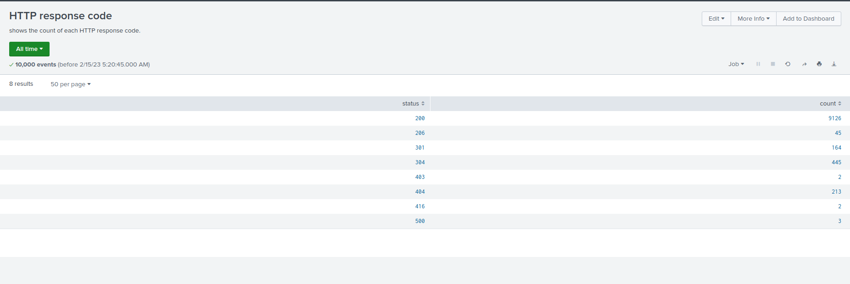
Images of Reports—Apache
Notes:
Melody
There were 9851 GET requests March 20, 2020.
The top referring sites were identified as www.semicomplete.com at approx. 84%
The 9126 received the 200 successful status response code on March 20, 2020.

Slide 21
Alerts—Apache
Designed the following alerts:
Alert Name | Alert Description | Alert Baseline | Alert Threshold
Country Activity | Threshold from countries not including the US | 125 | 150
JUSTIFICATION: The average hourly activity from other countries is roughly 125. this was found by taking the lowest and highest hourly activity and averaging them. We set our threshold at 150, to allow room for company growth and to not have alert fatigue. If attacks like a DDoS were to take place it would go well over the alert threshold.
Notes:
Ryan

Slide 22
Alerts—Apache
Designed the following alerts:
Alert Name | Alert Description | Alert Baseline | Alert Threshold
HTTP POST ALERT | HTTP POST Threshold >10 per hour | 5 | 10
JUSTIFICATION: Since POST’s per hour on an average day, can be as low as 0, or as high as 7. we can see an average baseline of roughly 4-5. having the Alert threshold at 10 will allow for those peaks of 7, and alert us if something unexpected could be going on.
Notes:
Ryan

Slide 23
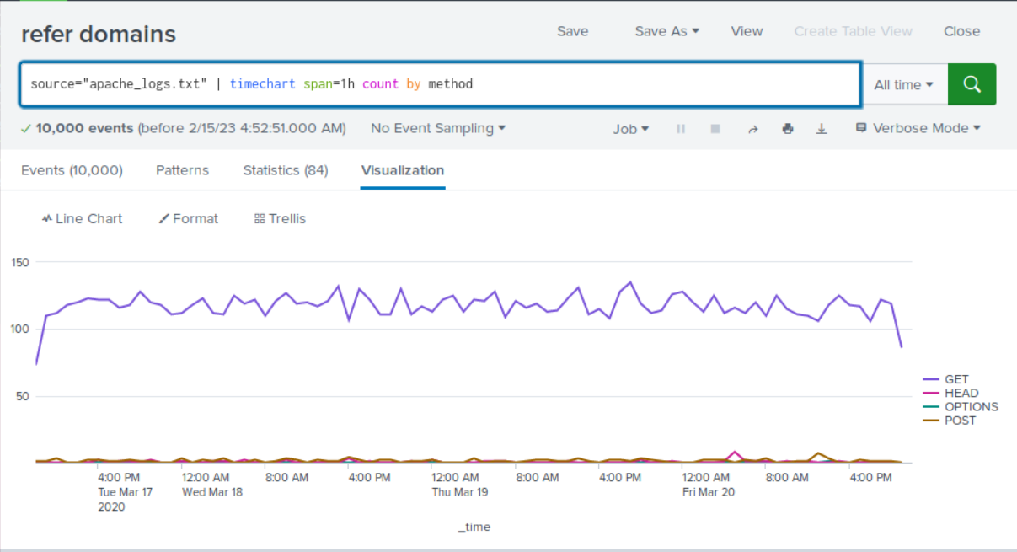
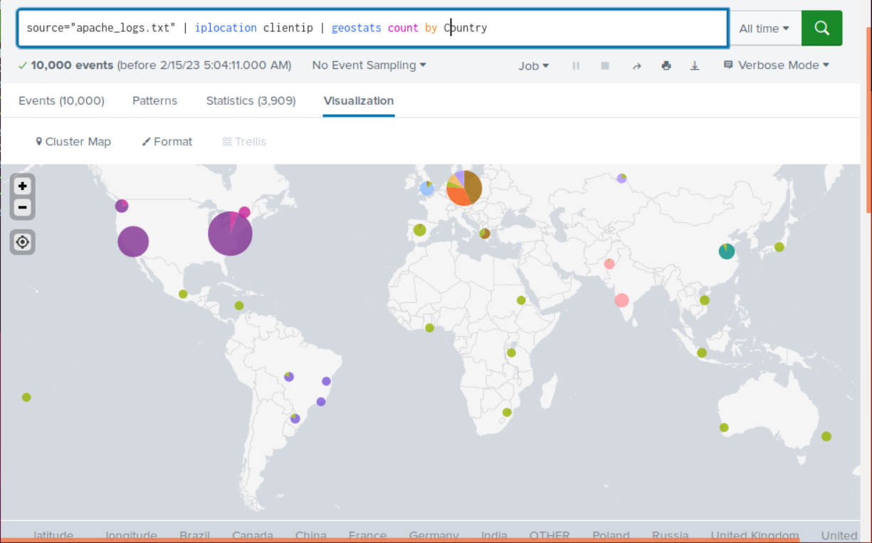
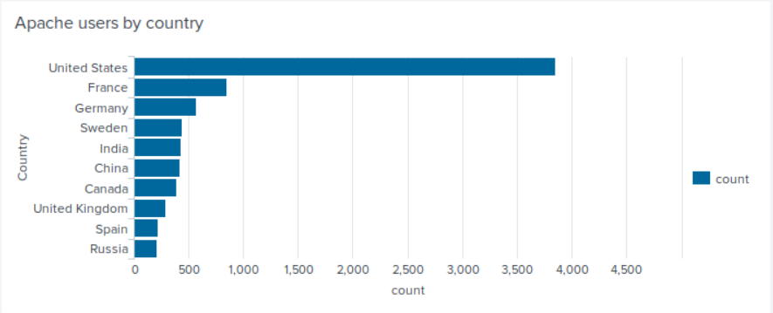
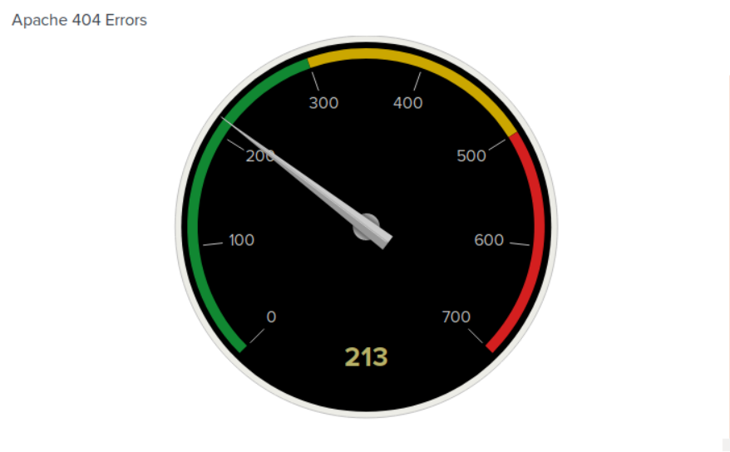
Dashboards—Apache
HTTP methods field values over time
Map of Clientip locations
Top 10 Countries by Users
404 Errors
Notes:
Ryan

Slide 24
Attack Analysis
‹#›

Slide 25
Attack Summary—Windows
Summarize your findings from your reports when analyzing the attack logs.
Report analysis for severity: Suspicious
Severity in total count in the column: High, greatly increased
329 in the day 1 server logs in comparison to 1111 in the attack logs
Report analysis for failed activities: Not Suspicious
failed activities were found to be lower
Notes:
Sam

Slide 26
Attack Summary—Windows
Summarize your findings from your alerts when analyzing the attack logs. Were the thresholds correct?
Alert analysis for failed windows activity: Suspicious
The total count of events in the hours it occurred was 35. The times being between 8am - 9am
Our alert would’ve been triggered for this event. Threshold was correct
Alert analysis for successful logins: Suspicious
The total count of events in the hours it occurred was 196. The primary user being user_j, at the times between 11am - 12pm
Our alert would’ve triggered for this event. However, threshold was too low
Alert analysis for user account deleted:
No suspicious volumes of accounts deleted
Notes:
Sam

Slide 27
Attack Summary—Windows
Summarize your findings from your dashboards when analyzing the attack logs.
Suspicious activity noted 2 users, User_A & User​ K
Start time and Stop time: User_A 1:40 am - 2:40 am | User_K 9:10 am - 11:00 am​
Peak Count of different users: User_A 785 | User_K 397​
Suspicious activity found with the signatures, specifically, “A user account was locked out” and “An attempt was made to reset an accounts password” as both had very high volumes of activity.​
“A user account…” peaked at a count of 785 and “An attempt…” peaked at 397.
Notes:
Faheem

Slide 28
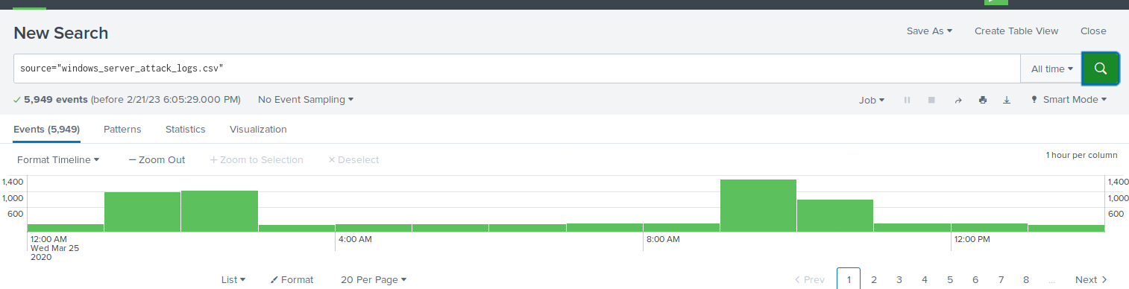
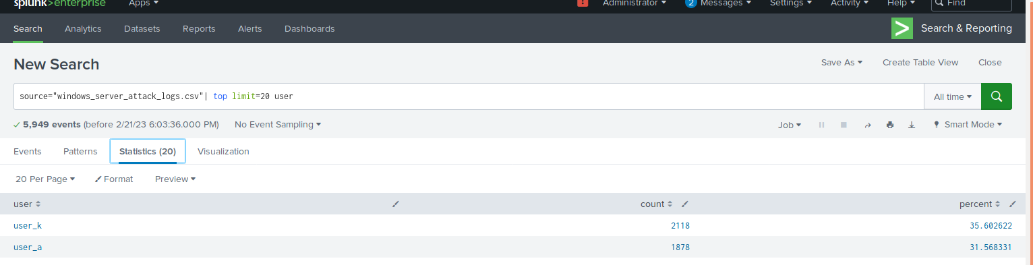
Screenshots of Attack Logs
Notes:
Faheem

Slide 29
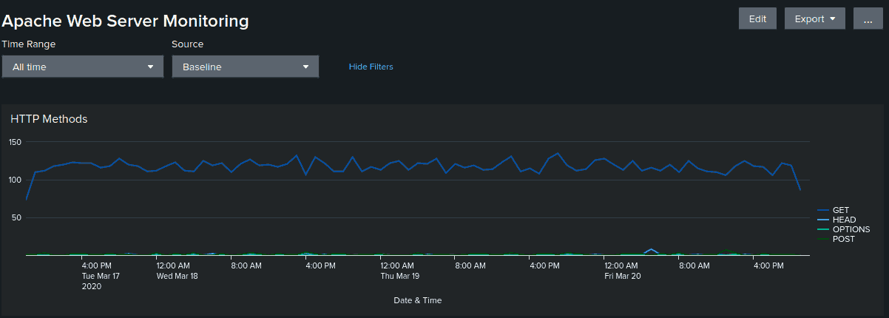
Attack Summary—Apache
Apache Web Server - HTTP Methods
An extreme volume of GET and POST methods, far above the baseline, occurred from 5pm to 9pm. The volume of POSTs is far more than GETs from 7pm to 9pm. The peak count of POSTs is 1296 during the attack at 8pm.
Notes:
Aman

Slide 30
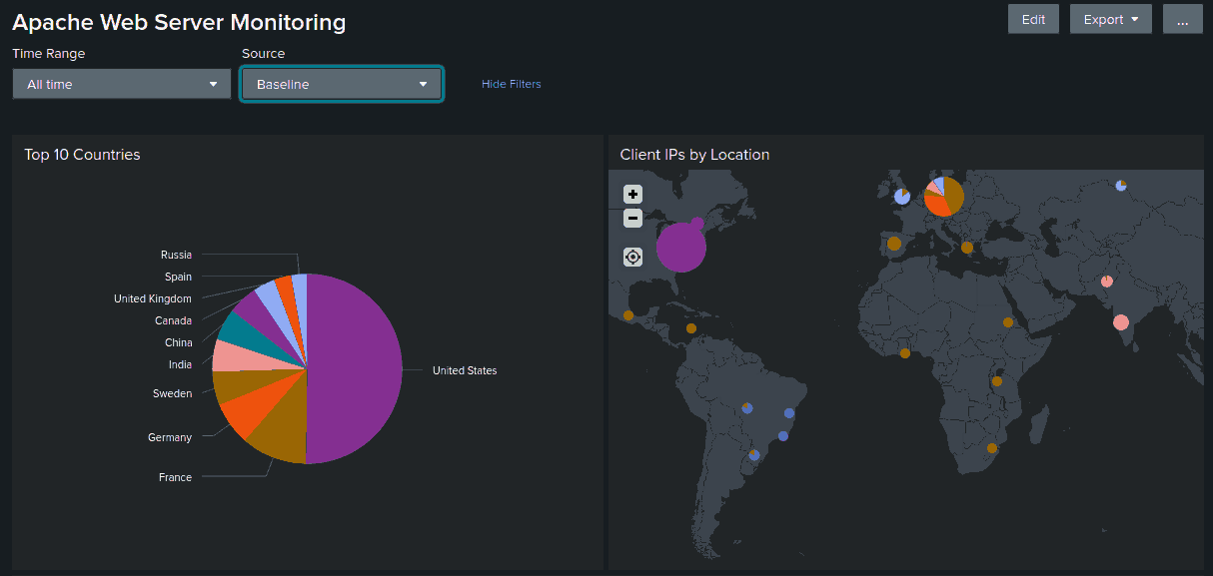
Attack Summary—Apache
Apache Web Server - Client IP - Countries
There is a drastic growth in the volume of IPs belonging to “OTHER” during the attack period which resolves to Ukraine, specifically the cities Kiev & Kharkiv.
Notes:
Sid
The volume of POSTs is far more than GETs from 7pm to 9pm. The peak count of POSTs is 1296 during the attack at 8pm.
There is a drastic growth in the volume of IPs belonging to “OTHER” during the attack period which resolves to Ukraine, specifically the cities, Kiev & Kharkiv.
A very large volume of hits to 2 URIs occurred on the attack day: 1323, /VSI_Account_logon.php 638, /files/logstash/logstash-1.3.2-monolithic.jar
The attacker seems to be brute forcing the login portal for VSI and accessing the java archive for the Logstash tool, used for collecting, processing, and managing logs.

Slide 31
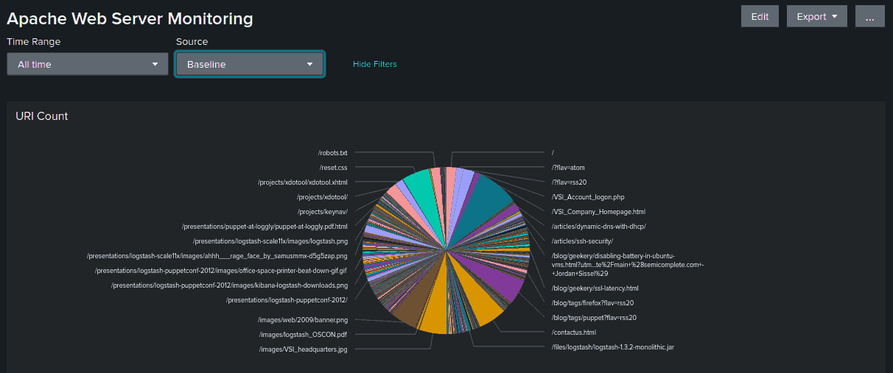
Attack Summary—Apache
Apache Web Server - URI Count
A very large volume of hits to 2 URIs occurred on the attack day: 1323, /VSI_Account_logon.php
Notes:
Sid
The volume of POSTs is far more than GETs from 7pm to 9pm. The peak count of POSTs is 1296 during the attack at 8pm.
There is a drastic growth in the volume of IPs belonging to “OTHER” during the attack period which resolves to Ukraine, specifically the cities, Kiev & Kharkiv.
A very large volume of hits to 2 URIs occurred on the attack day: 1323, /VSI_Account_logon.php 638, /files/logstash/logstash-1.3.2-monolithic.jar
The attacker seems to be brute forcing the login portal for VSI and accessing the java archive for the Logstash tool, used for collecting, processing, and managing logs.

Slide 32

Attack Summary—Apache
The attacker seems to be DDoSing and brute forcing the login portal for VSI.
Notes:
Sid
The volume of POSTs is far more than GETs from 7pm to 9pm. The peak count of POSTs is 1296 during the attack at 8pm.
There is a drastic growth in the volume of IPs belonging to “OTHER” during the attack period which resolves to Ukraine, specifically the cities, Kiev & Kharkiv.
A very large volume of hits to 2 URIs occurred on the attack day: 1323, /VSI_Account_logon.php 638, /files/logstash/logstash-1.3.2-monolithic.jar
The attacker seems to be brute forcing the login portal for VSI and accessing the java archive for the Logstash tool, used for collecting, processing, and managing logs.

Slide 33
Summary and Future Mitigations
‹#›

Slide 34
Project 3 Summary
What were your overall findings from the attack that took place?
This attack was focused on windows and apache servers. The attacker used IPs that were pointing to Ukraine cities (Kiev and Kharkiv). The attacker focused on two specific URIs (/VSI_Account_logon.php and /files/logstash/logstash-1.3.2-monolithic.jar) one of them being the login portal for VSI and was likely the target of a brute force attack.
To protect VSI from future attacks, what future mitigations would you recommend?
Implementing a Web Application Firewall (WAF) that can better detect and block these abnormal traffic patterns (like abnormally high GET and POST requests)
Using IP filtering to block the addresses where the attacks originated (“Other” category)
use multi-factor authentication to make it harder to brute force passwords in the future
regularly review the logs for suspicious and unusual activity
Notes:
Fatima Mansoor

